Slide 1


The Biodiversity Data Journal
Towards next-generation, integrated narrative and data publishing
Lyubomir Penev, Teodor Georgiev, Pavel Stoev, Jordan Biserkov, Laurence Livermore, Jeremy Miller, David Roberts, Vincent Smith
Data Publishing Meeting, Taipei 19-22 Nov 2013
ViBRANT

Slide 2








Life cycle of biodiversity data
Occurrence data
Any other data
Genomic dada
Morphometric data
Biodiversity
manuscript
Phylogenetic data
Image galleries
Environmental
data
XML
MARK UP
Structured text
(data!)
ARTICLES
Biblio-
graphies
Occurr-
ence data
Taxon treatments
Taxon names
Plazi
Wiki
COL
BHL

Slide 3
Multiple Scholarly Data Publishing Models
Supplementary data files downloadable from the journals’ websites
Data linked to journal articles but deposited at specialized repositories (Dryad, Pangaea, etc.)
Data linked to journal articles but deposited, indexed and collated with other data by aggregators (INSD/GenBank, GBIF)
Data published in structured, downloadable and machine-readable article text.

Slide 4
The problem?

Slide 5
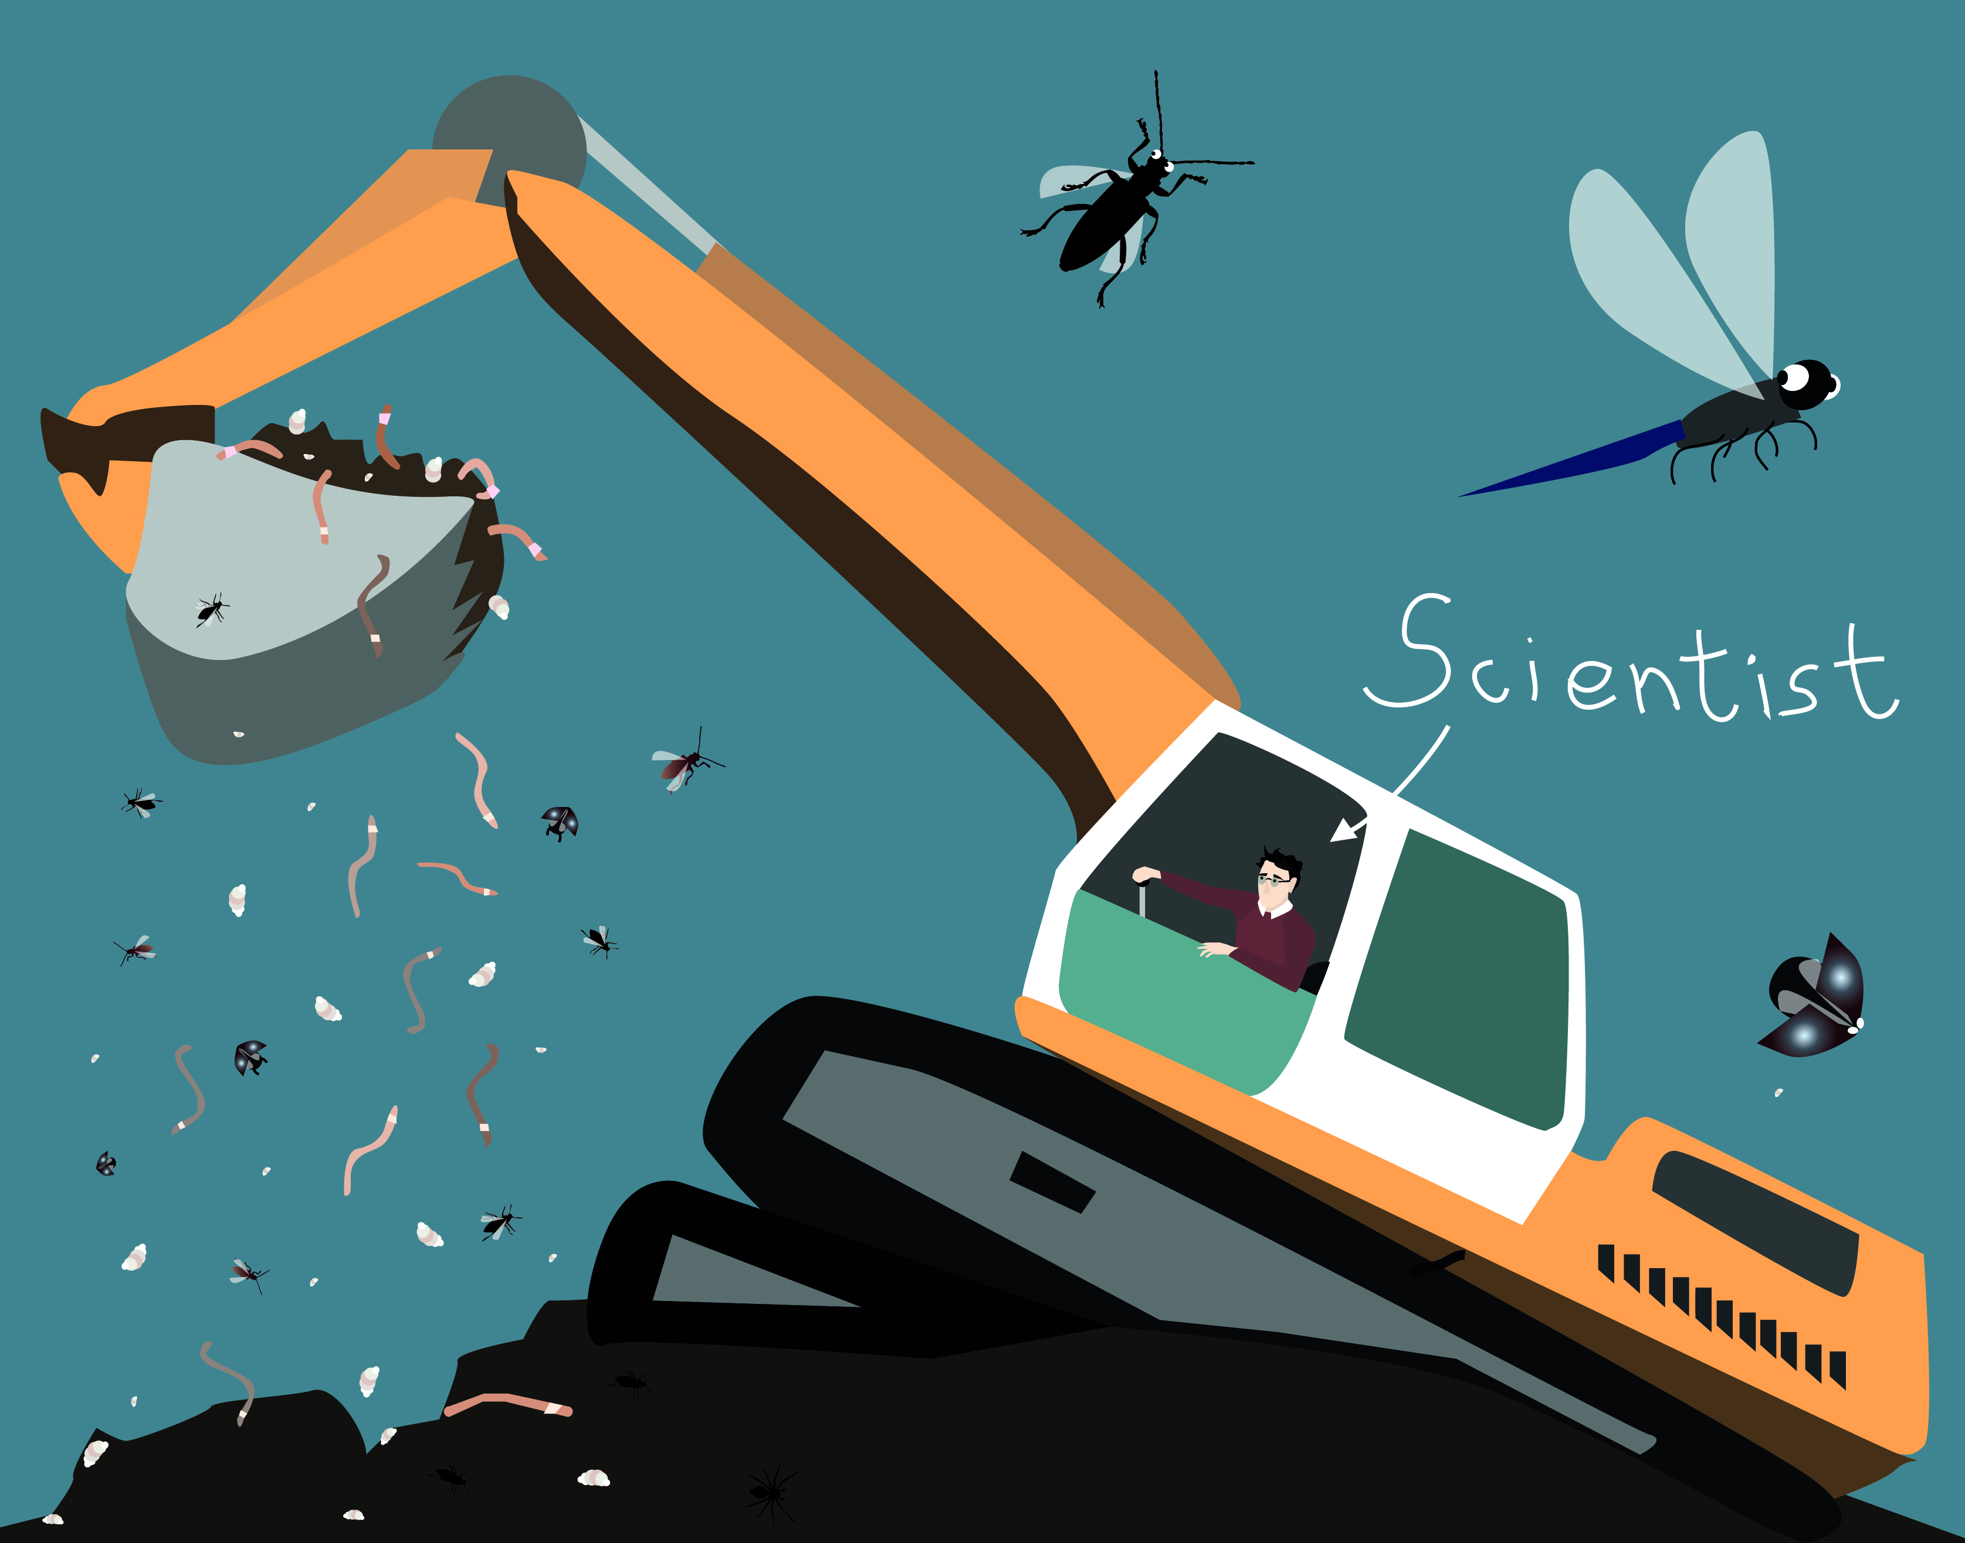
Data deluge: Massive sampling

Slide 6
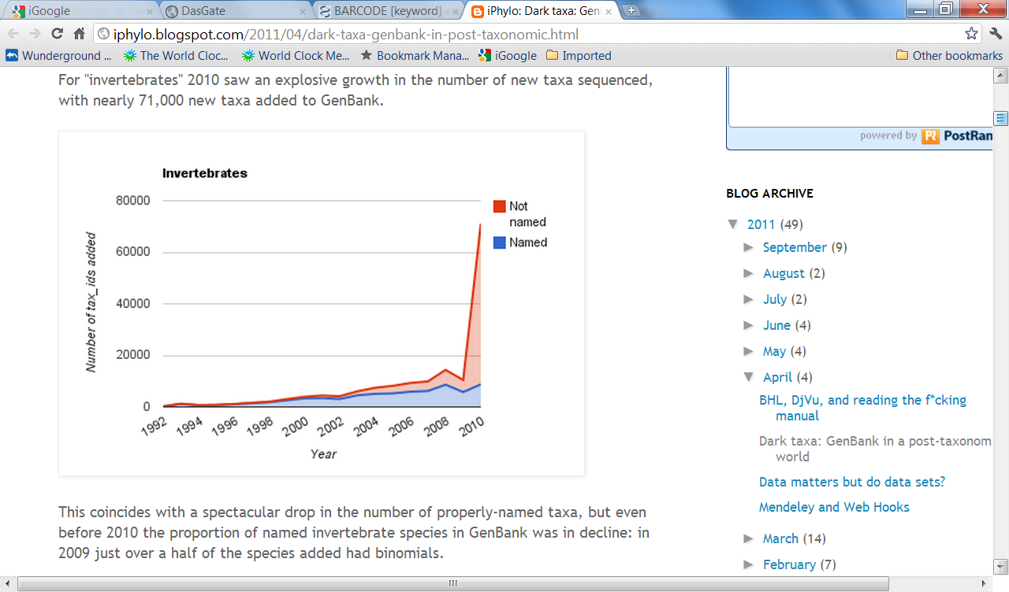
‘Dark Taxa’ increase dramatically!
Rod Page, iPhylo blogspot, 12 April 2011

Slide 7

The paper/PDF impediment

Slide 8
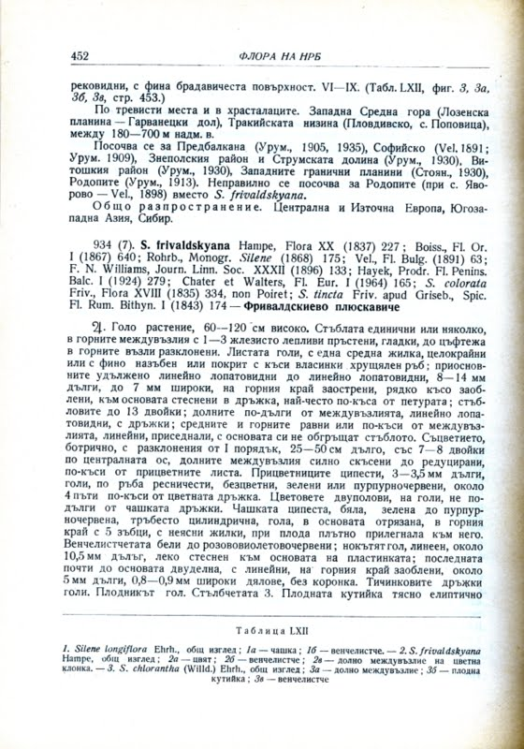
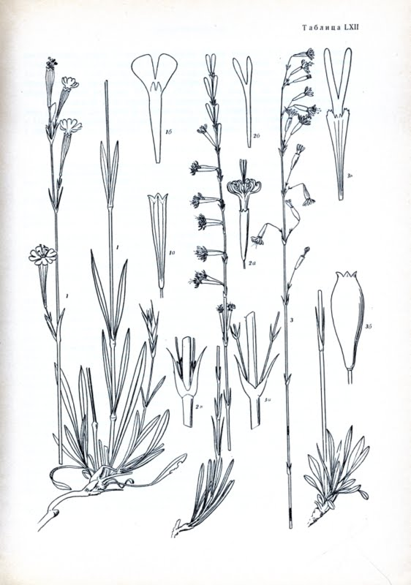
… the burden or OCR, double-keying and markup of paper/PDF literature

Slide 9
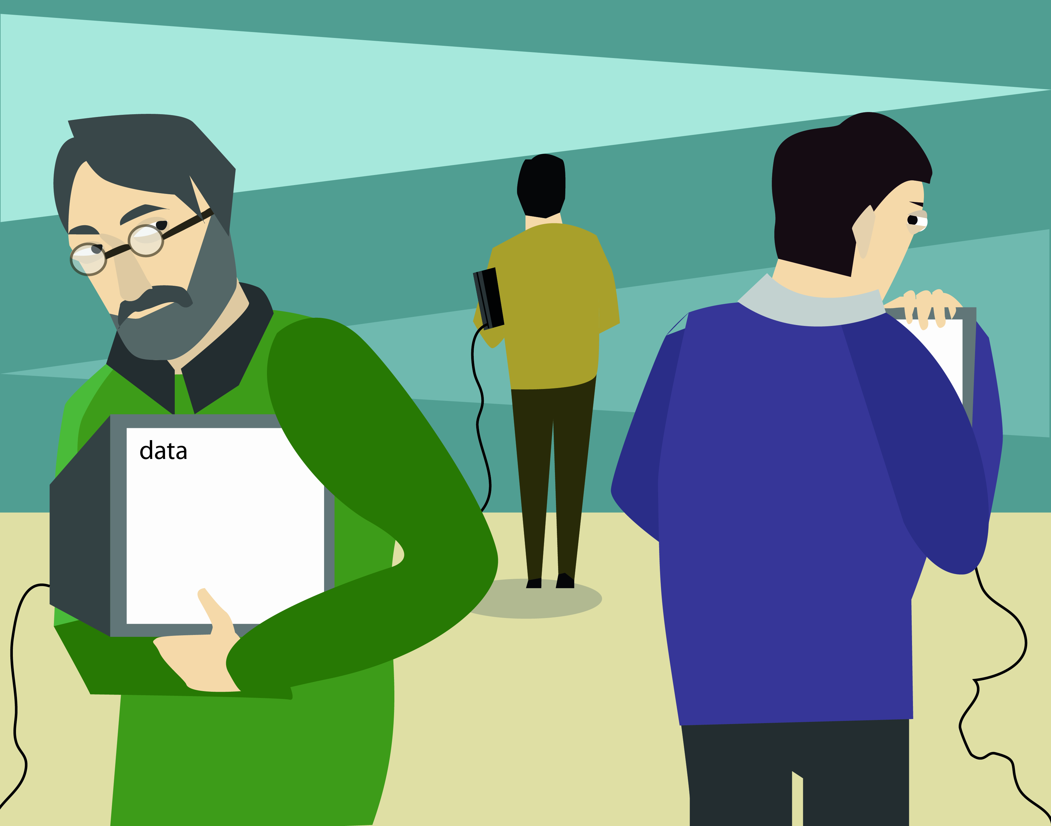
Low uptake of data publishing & sharing

Slide 10

The “impact factor” pressure

Slide 11
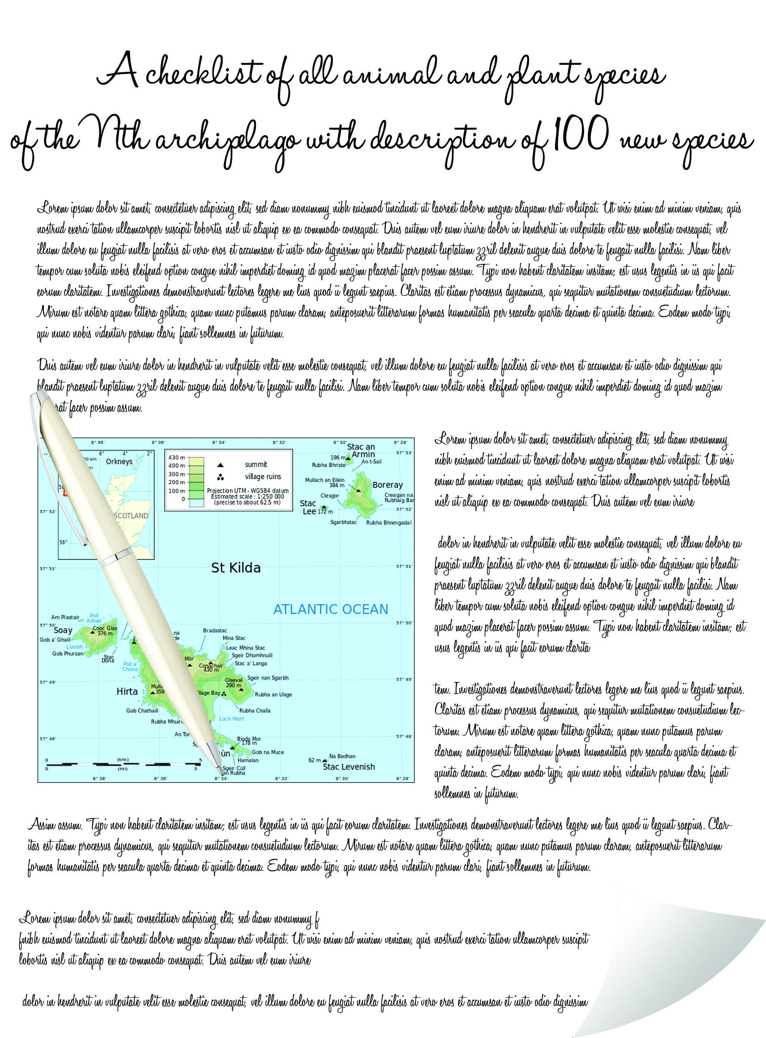

Slide 12
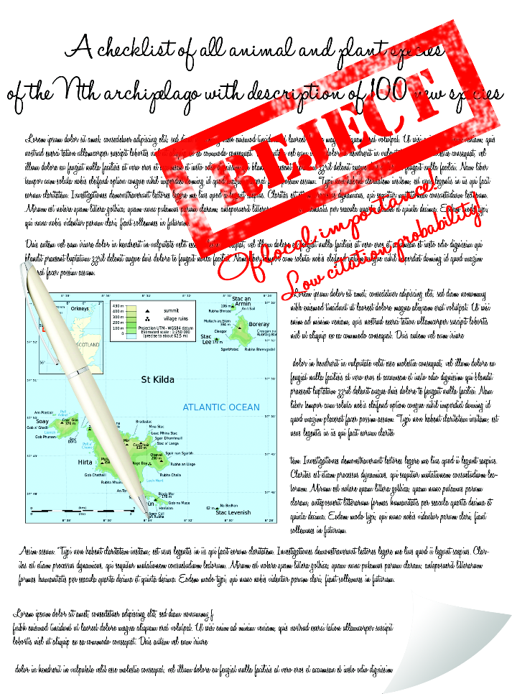

Slide 13
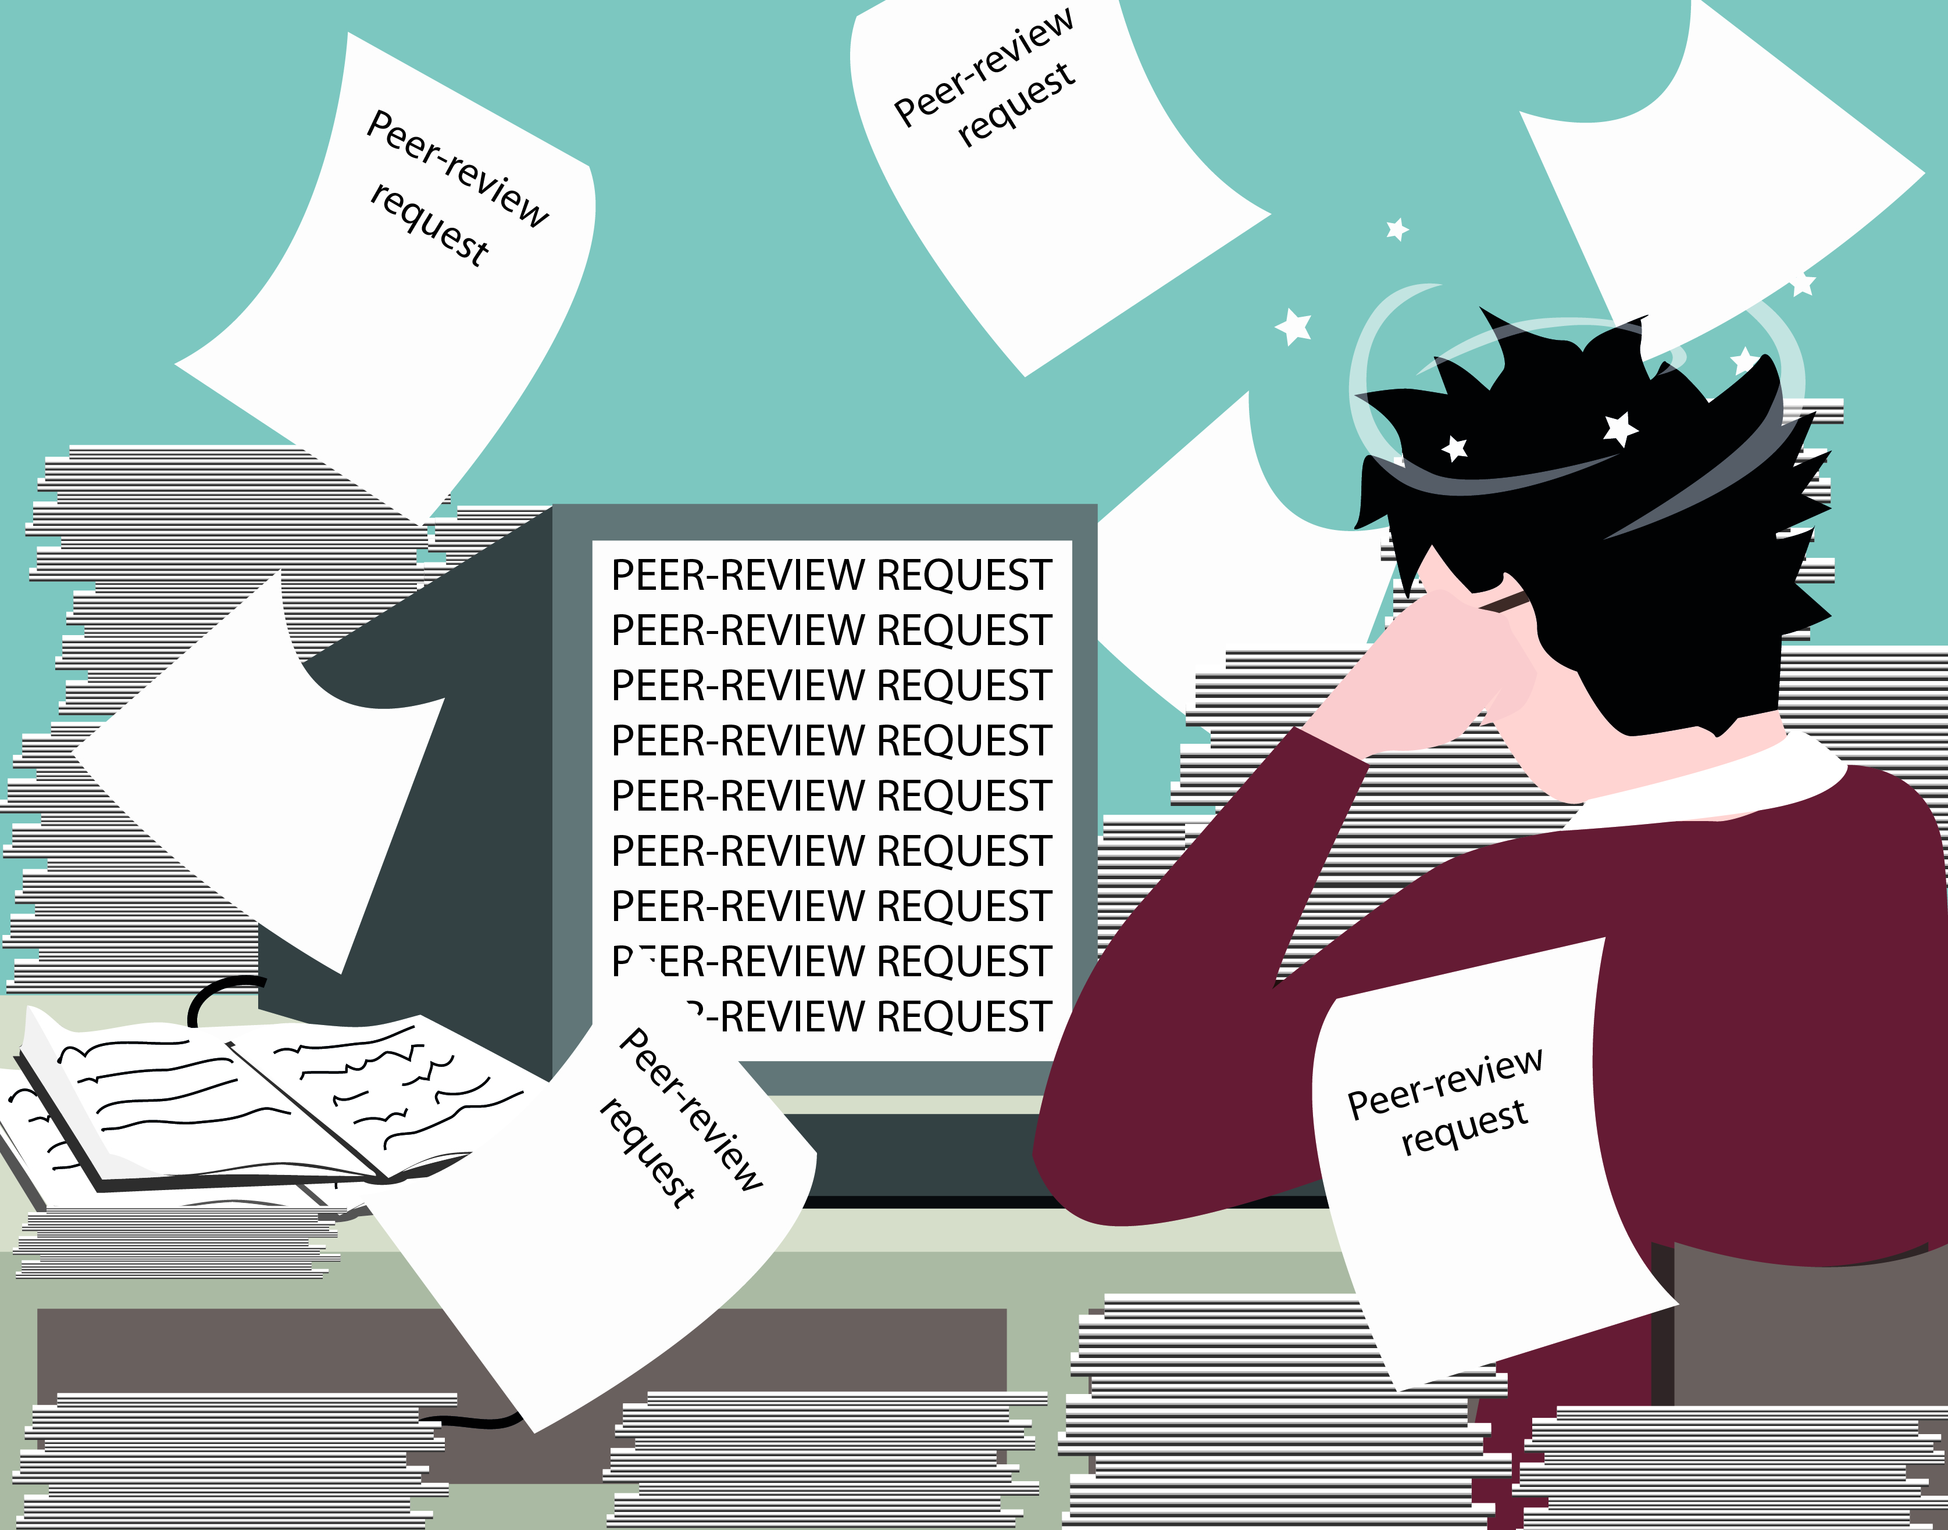
The “peer review” pressure

Slide 14


As a result, data remain unpublished and often get lost!
Primary data

Slide 15
The solution?

Slide 16
Data papers

Slide 17
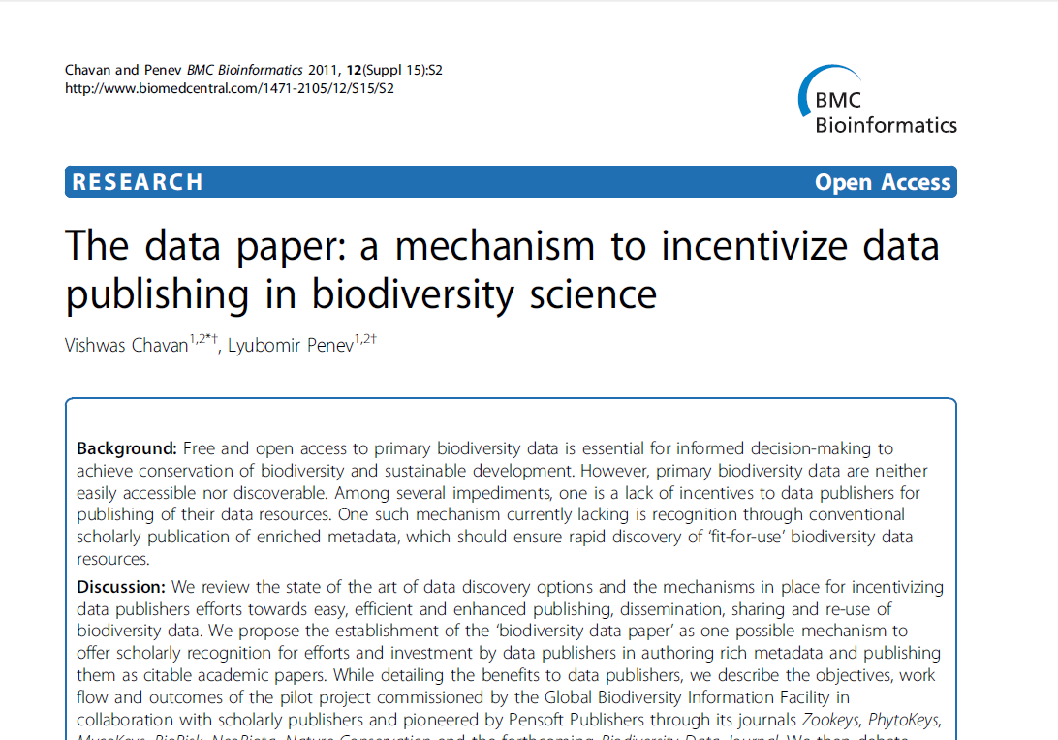
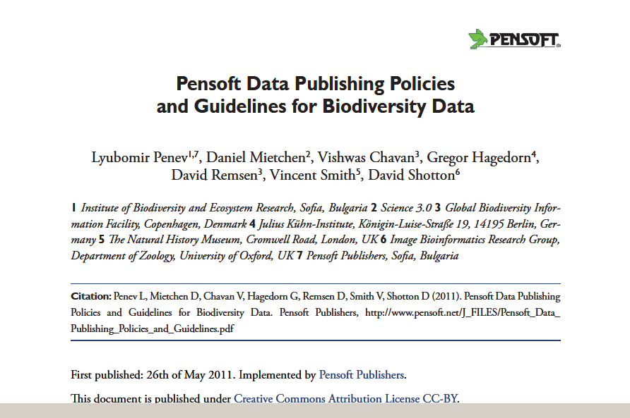
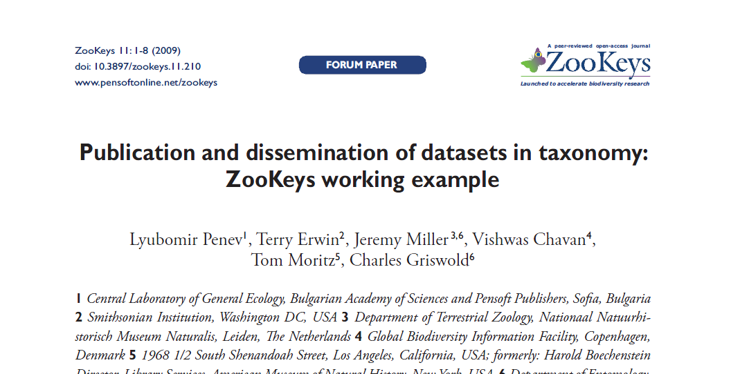

Slide 18
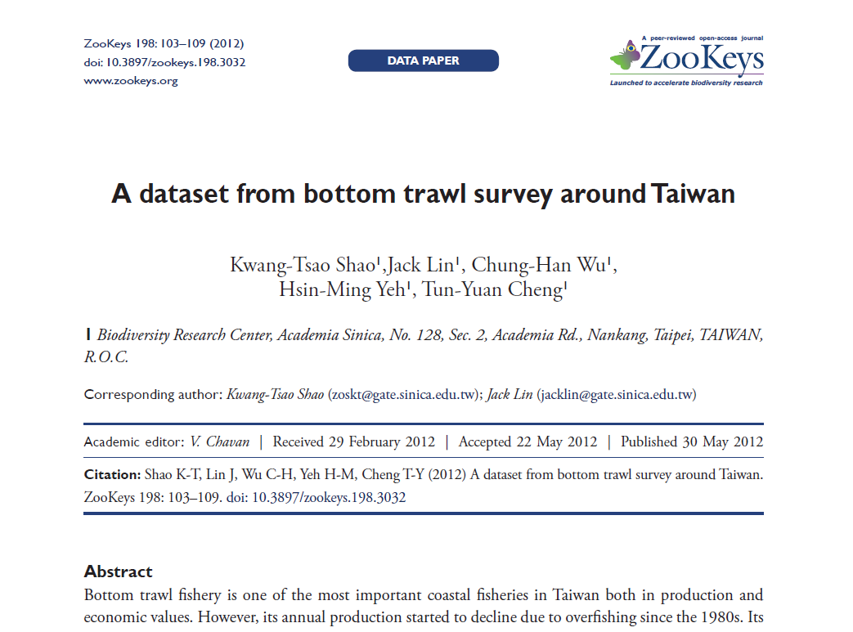

Slide 19
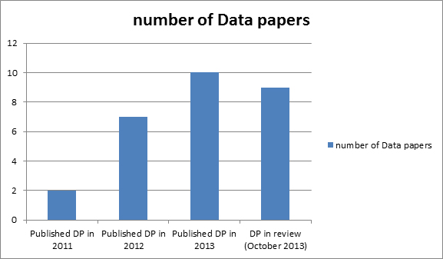
Growth of data papers

Slide 20
Next generation data publishing

Slide 21
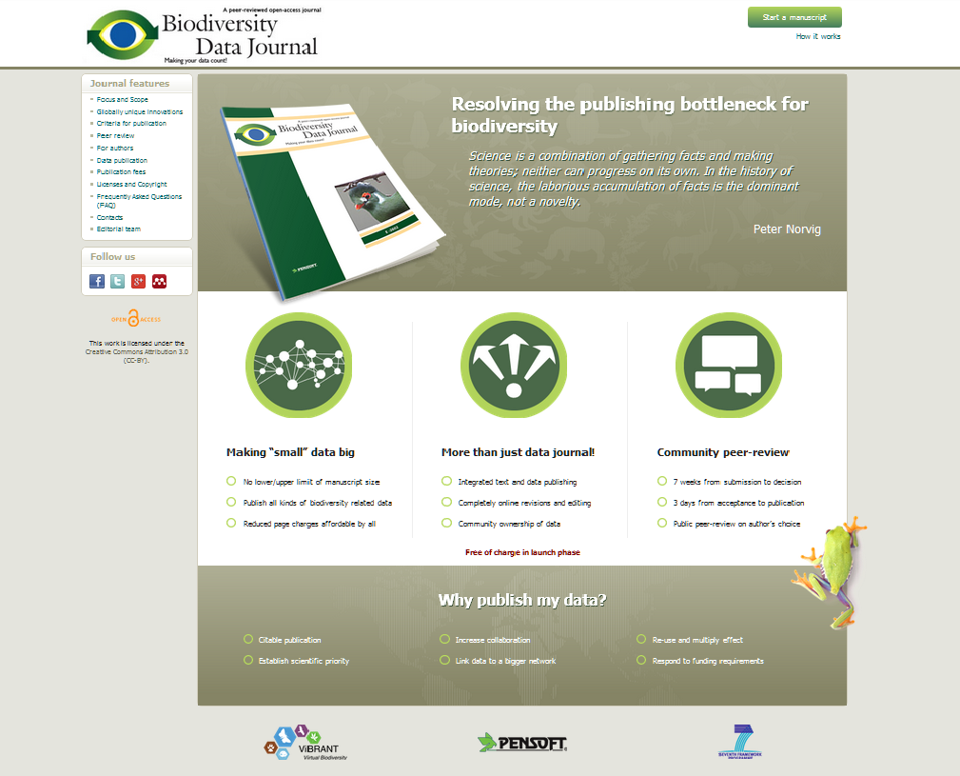

Slide 22
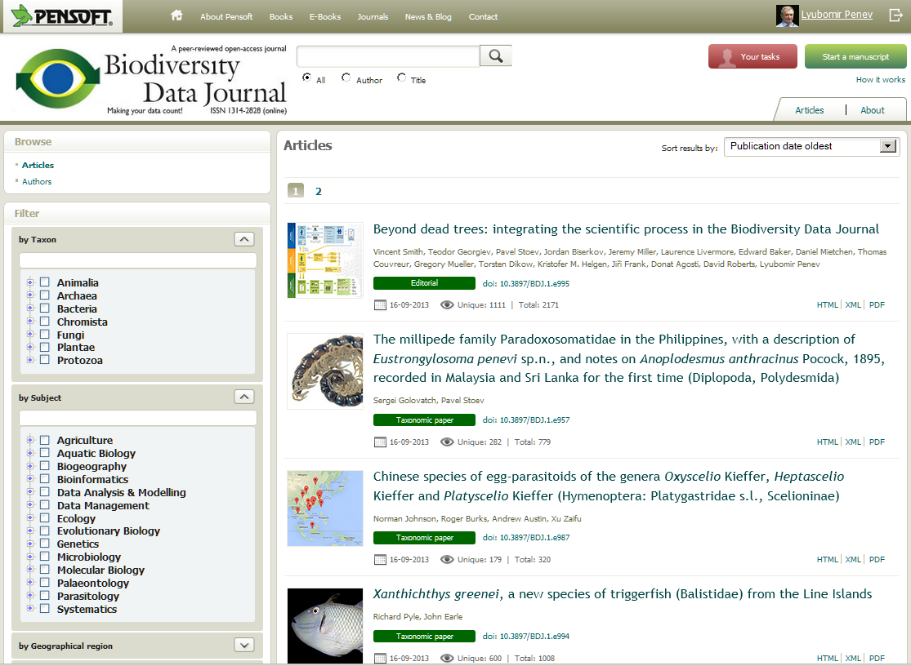

Slide 23
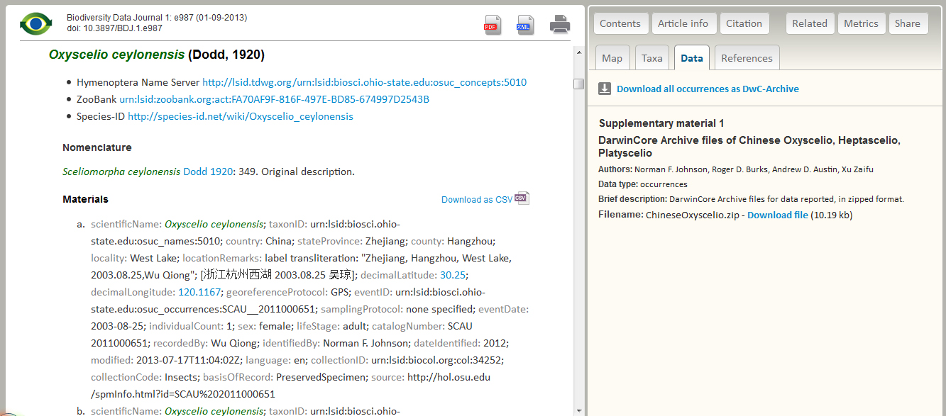
Harvesting data straight from article

Slide 24

Novel concepts
Authoring, reviewing and publishing in one place, for first time!
Upfront markup!
“Small” data imported in and downloadable from text
Large datasets published as data papers
Text stored and treated as data
Community peer-review and community ownership of interoperable data
Narrative (text) and data integrated publishing!

Slide 25

How BDJ does that?
Collaborative
ARTICLE AUTHORING
(PENSOFT WRITING
TOOL)
Automatedsubmission
Community peer-review
(options for public and
Open review)
ALL ONLINE!
Revisions
online
Authors, Reviewers, Editors, Mentors, Copyeditors
MANUSCRIPT published
XML text + data
ARTICLES
Biblio-
graphies
Occurr-
ence data
Taxon treatments
Taxon names
Plazi
Wiki
COL

Slide 26
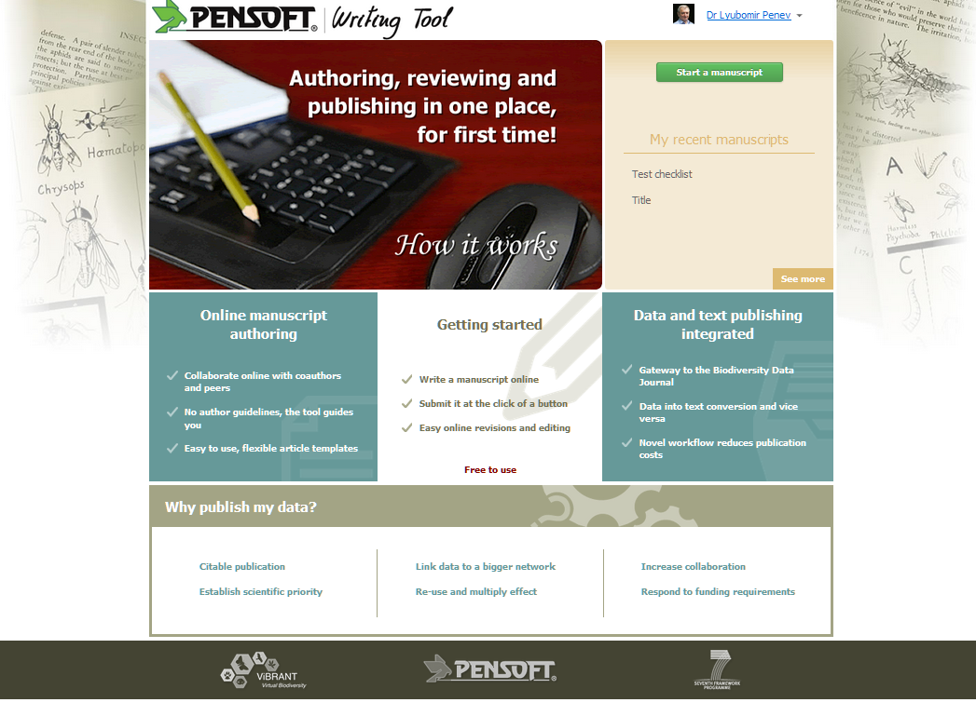

Slide 27
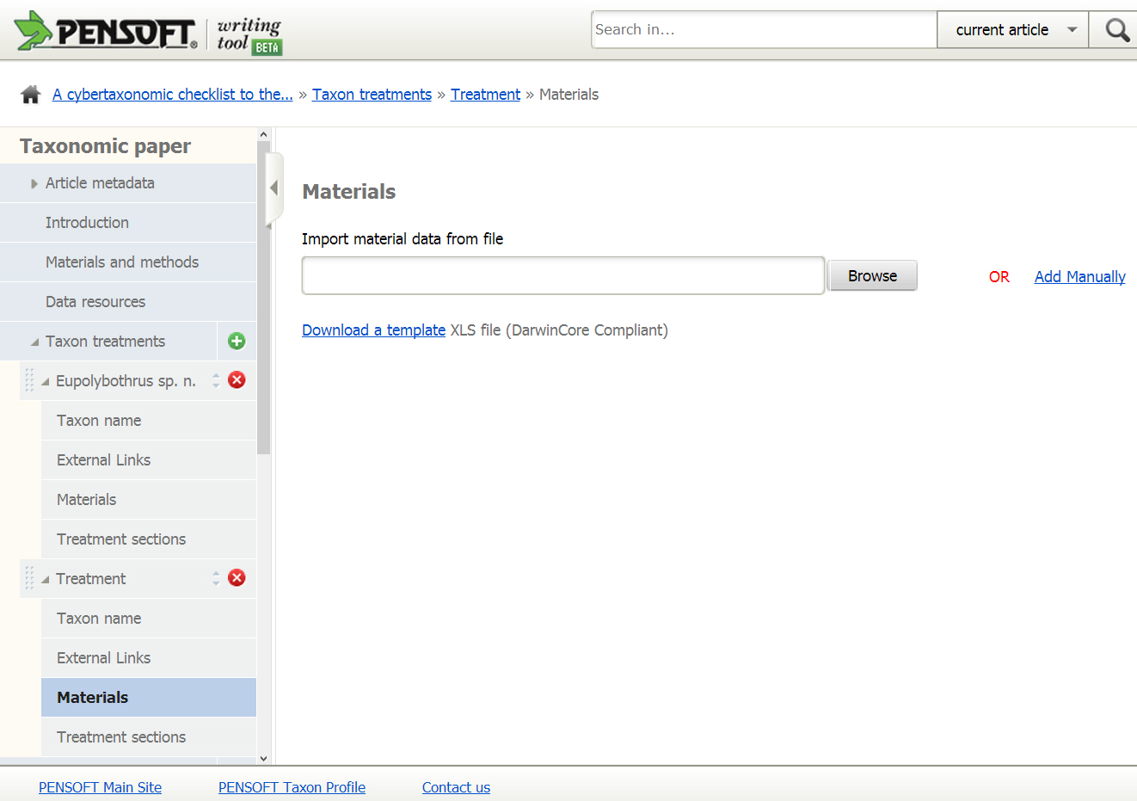
Import DwC data

Slide 28
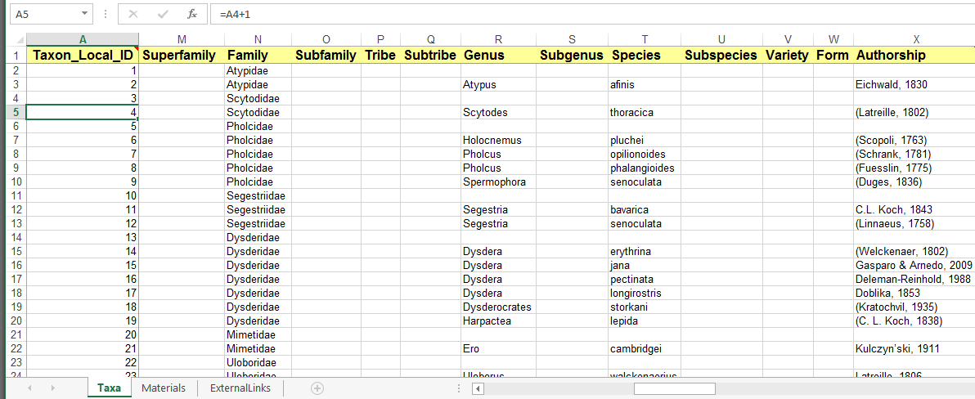
DwC Template

Slide 29
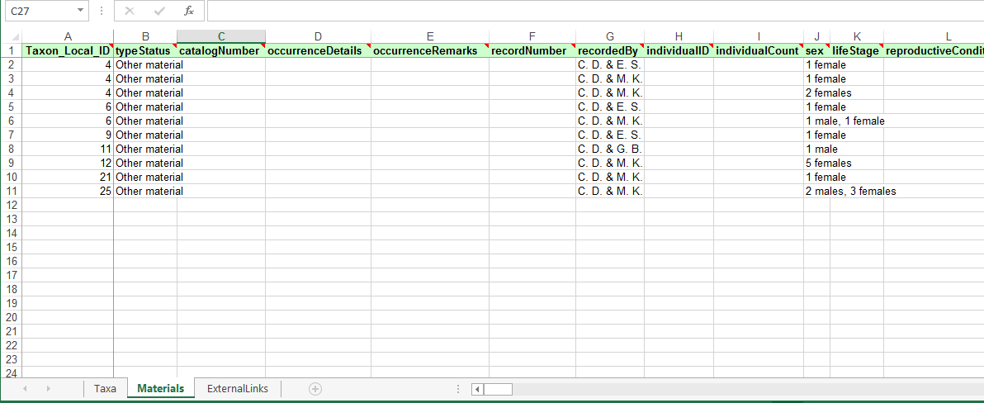
DwC Template

Slide 30
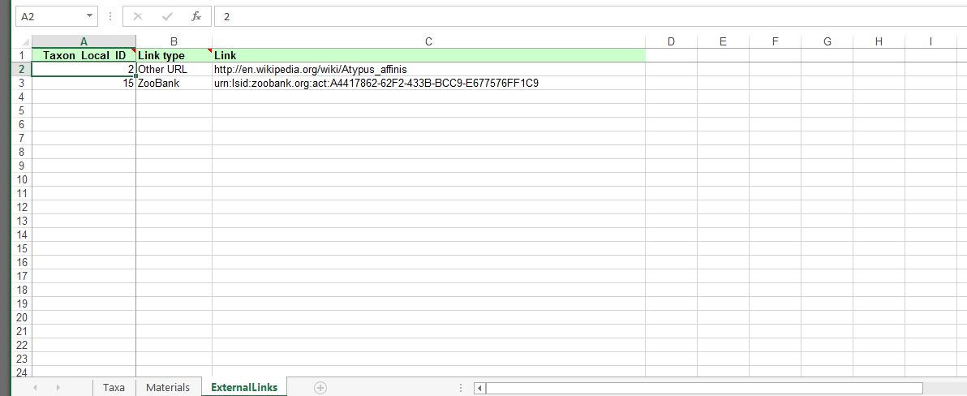
DwC Template

Slide 31
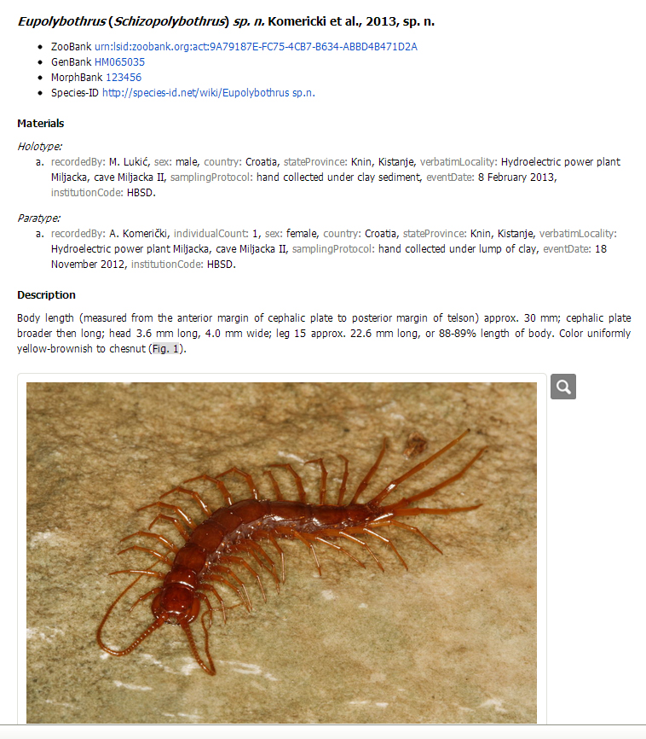
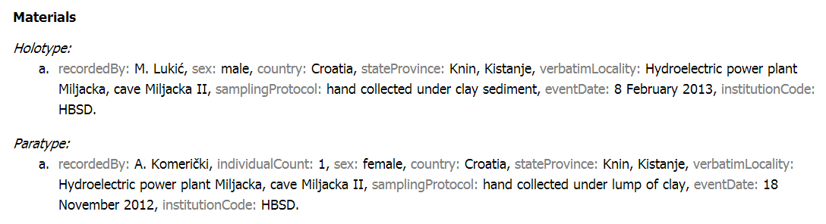
DwC terms visible in text

Slide 32
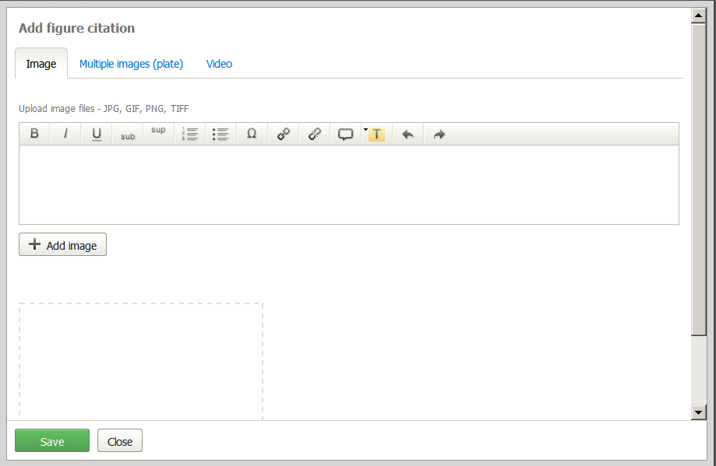
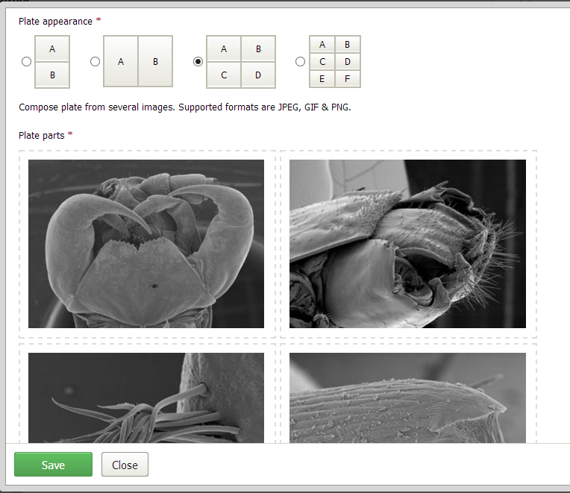
Compose plates

Slide 33
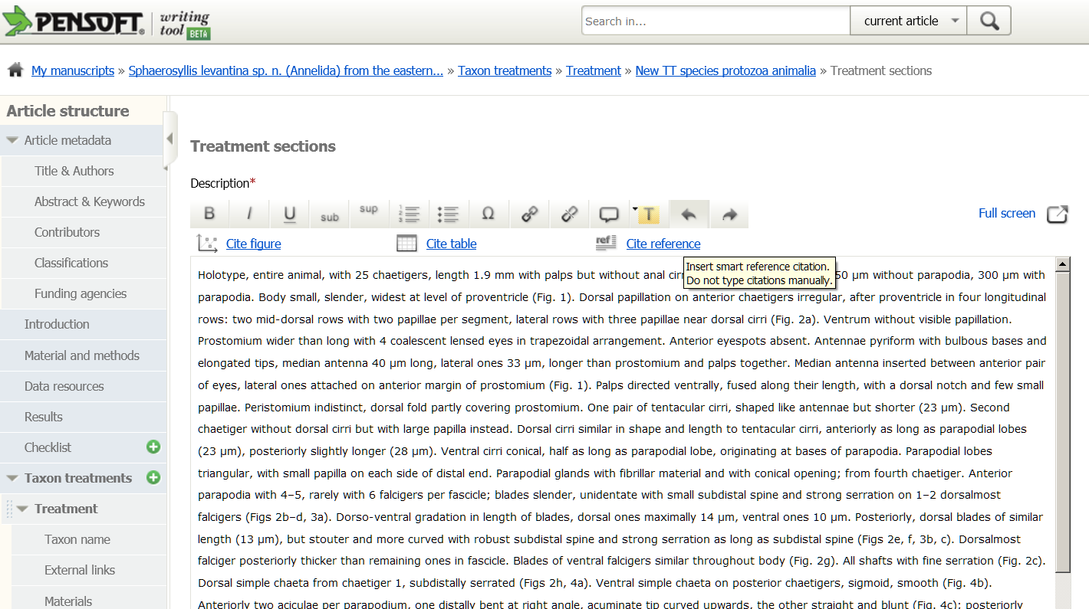

Slide 34
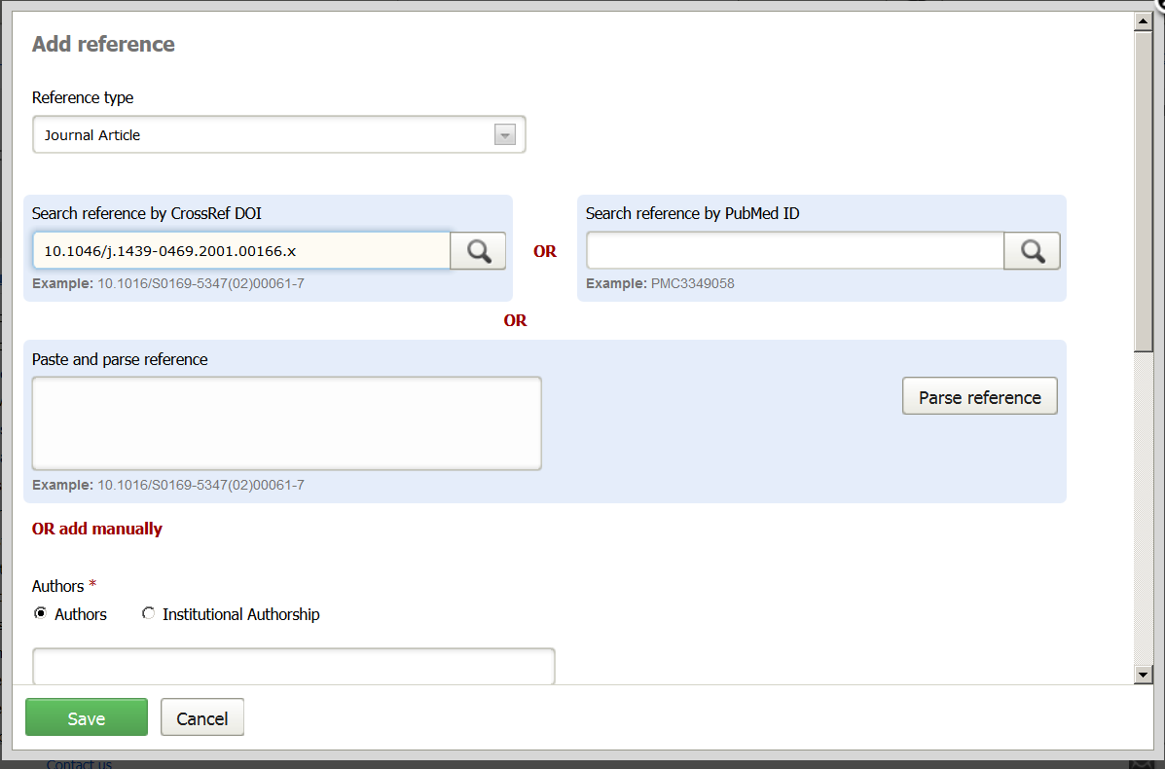
Pick up a reference

Slide 35
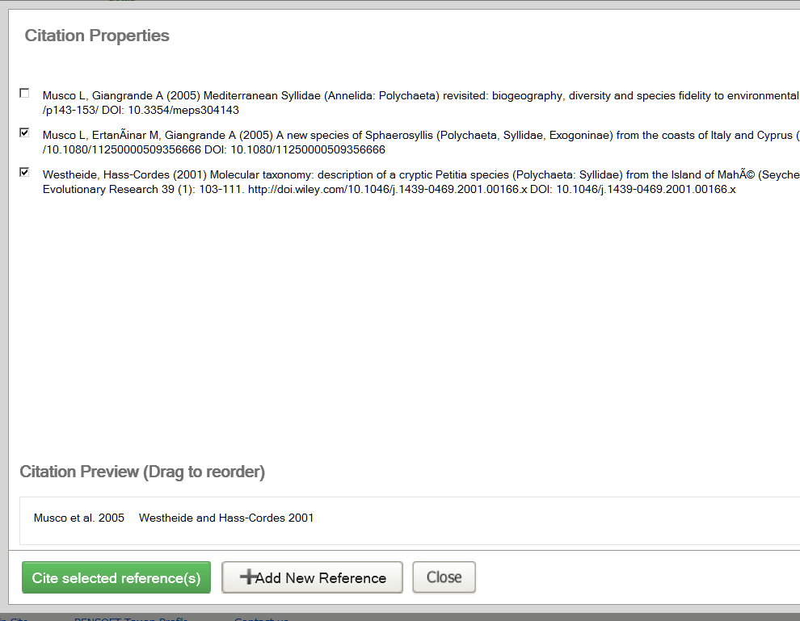
Cite a reference

Slide 36
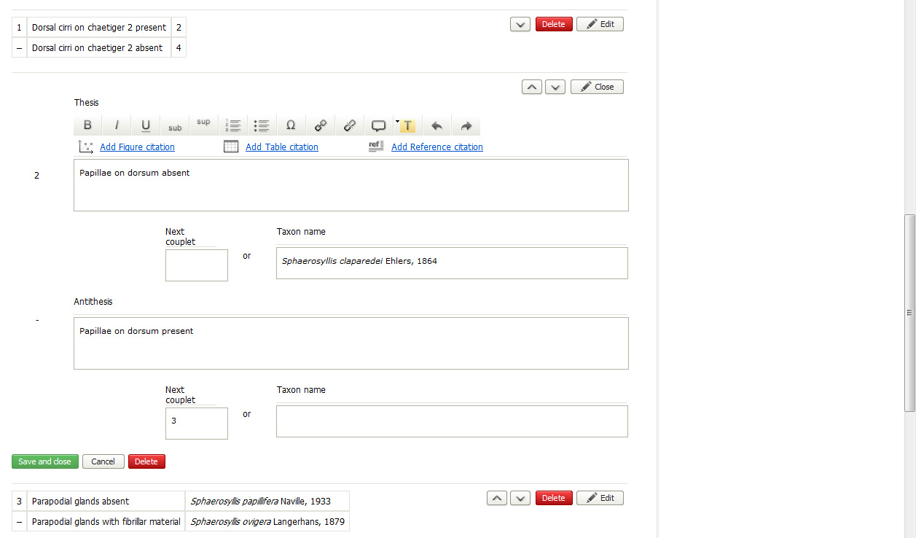
Construction
of keys

Slide 37
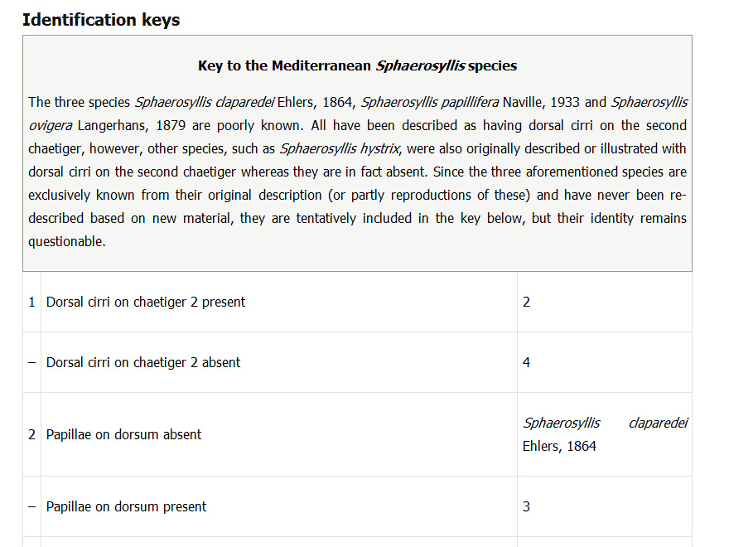
Key preview

Slide 38
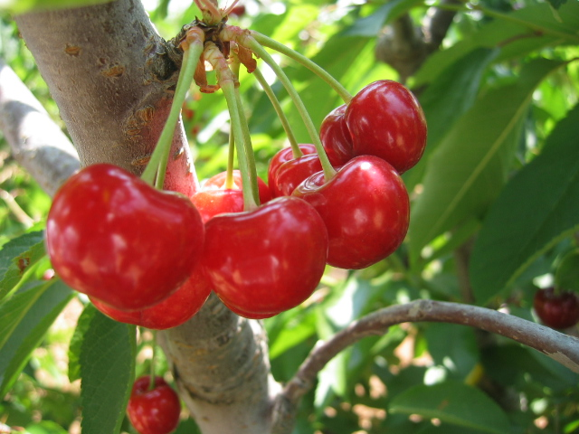

Slide 39
No author guidelines! The tool will guide you!

Slide 40
Authors do not need to markup or hyperlink anything!
It is done by the tool!

Slide 41
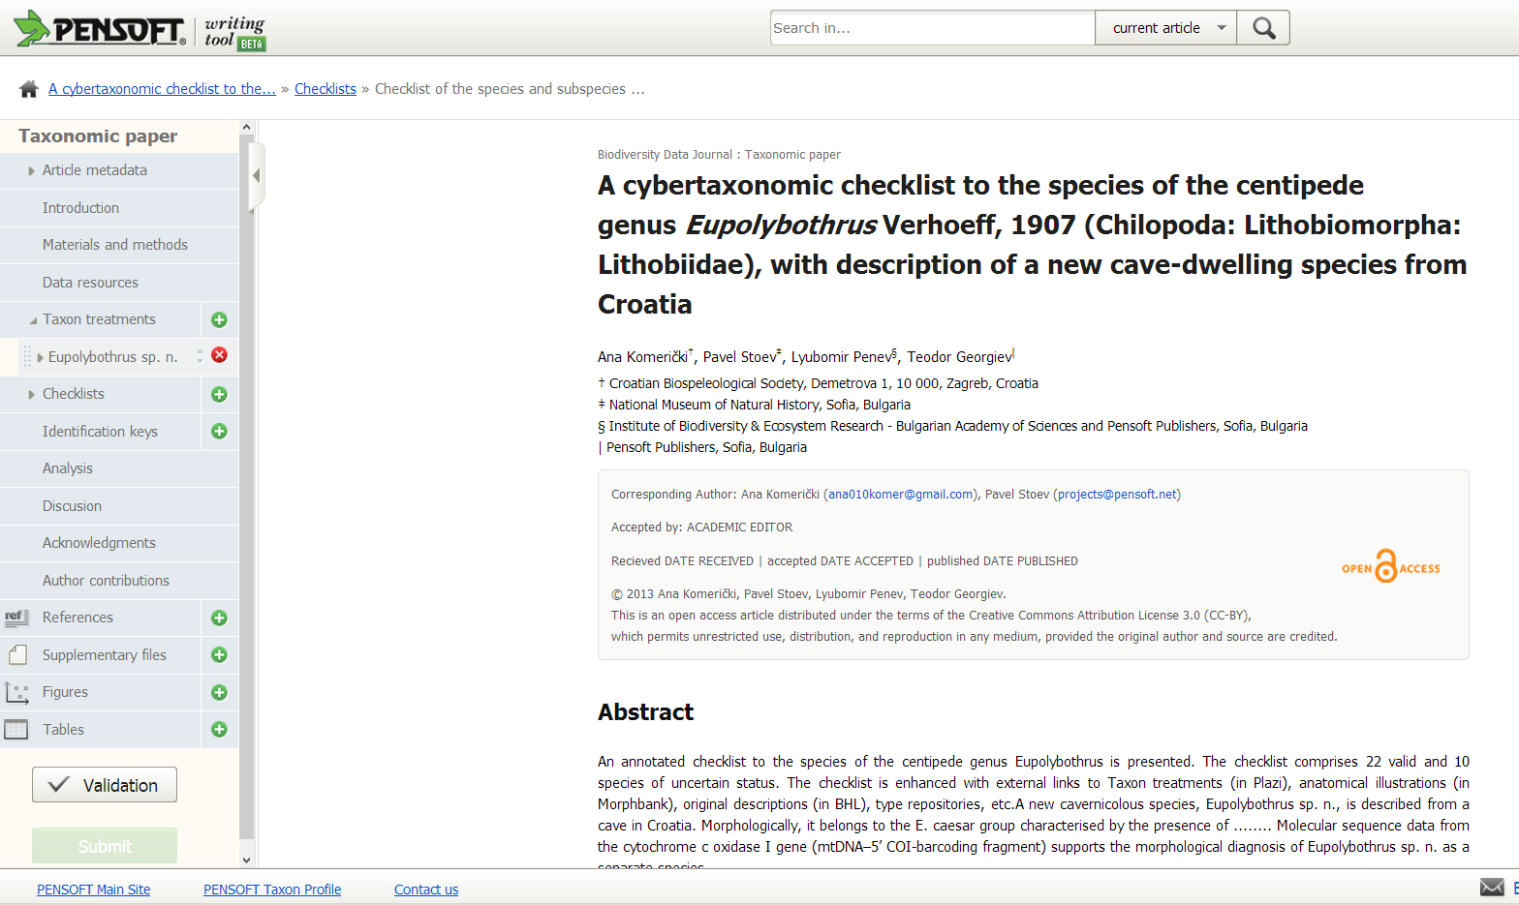
No layout stage!

Slide 42
Community and public peer-review
Notes:
42
Slide 12: Next generation article publishing
Arguably our most ambitious developments in the context of scholarly communication concern the semi-automated construction of scholarly papers from databases. In many cases Scratchpads contain extensive data relating to the biology and description of particular species. These are highly suited to formal specialist publications, but doing so require the laborious assembly of these data into a manuscript. As part of the ViBRANT collaboration with Pensoft, and in particular their two journals specialising in the formal taxonomic descriptions of plants and animals, we have developed a 5-step workflow for users to selecting appropriate data from their Scratchpad, adding additional metadata describing this information so that it conforms with the norms of descriptive taxonomic publications, and then finally preview and submit this manuscript to the publisher. From here is goes through a standard peer review process. Review recommendations are then incorporated in to a revised version of the manuscript, which is then sent back to the publisher and simultaneously published on both the Scratchpad and in the publisher’s journal.
In addition to dramatically speeding up the construction of scientific papers, the user has the advantage that firstly the manuscript can be revised and updated and new information comes to light on the Scratchpad, while preserving the original version of the manuscript as part of the scholarly record. In addition the publish extracts relevant information from the submitted database which is them automatically submitted to the specialist data repositories.
So in sum then, these are the four ways in which ViBRANT is facilitation scholarly communication of biodiversity information. 1) Through low cost journal infrastructure; 2) by community web publishing; 3) by biodiversity observation data publishing; and 4) by next generation publishing services producing scholarly articles from databases.

Slide 43
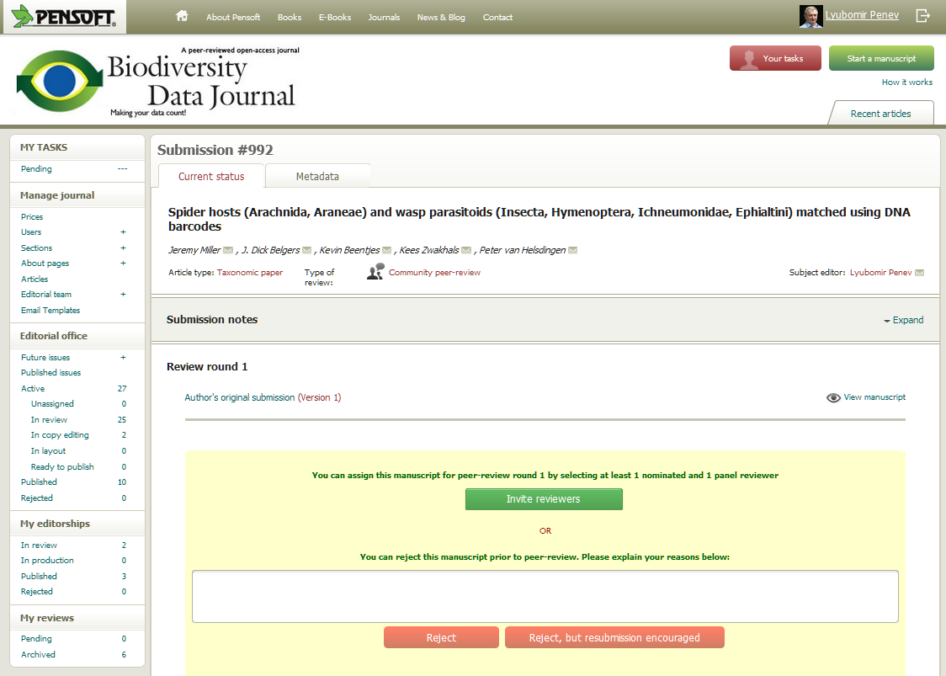

Slide 44
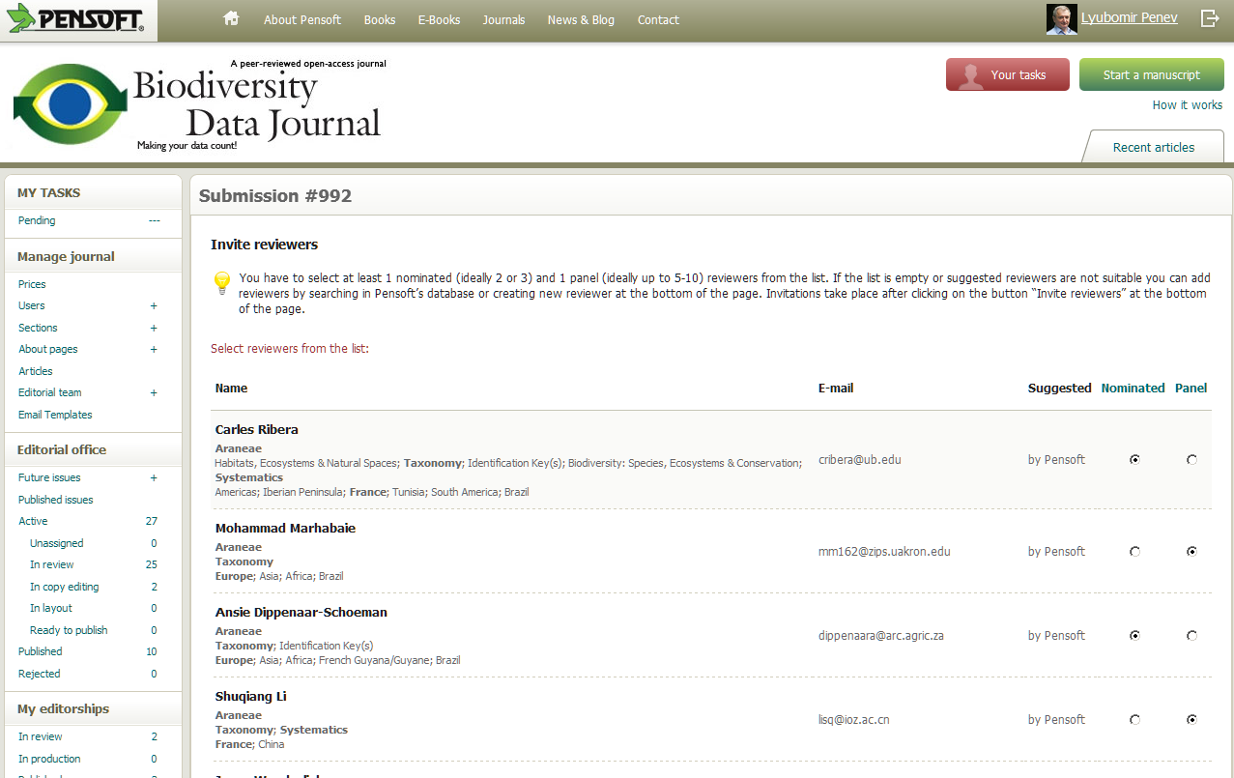

Slide 45
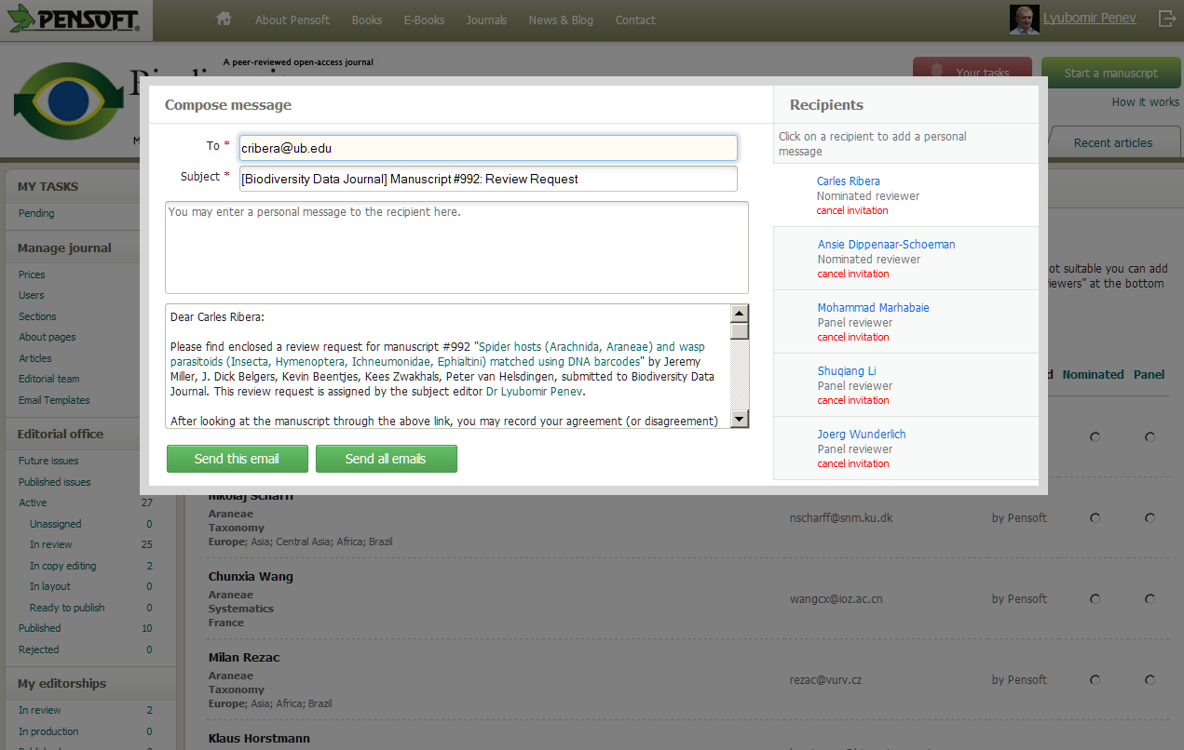
Now imagine…

Slide 46
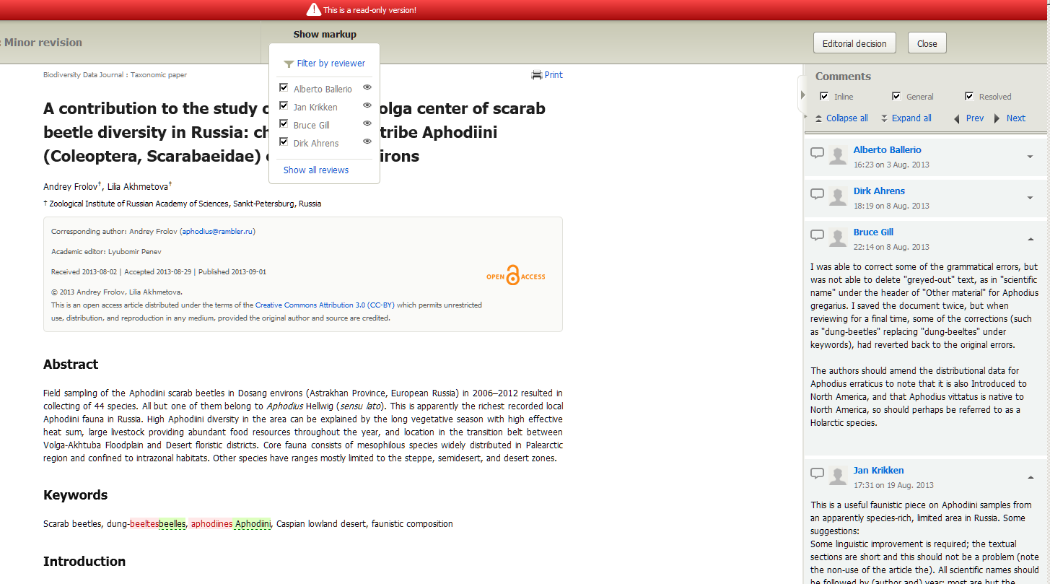
Consolidated Reviewers’ Version

Slide 47
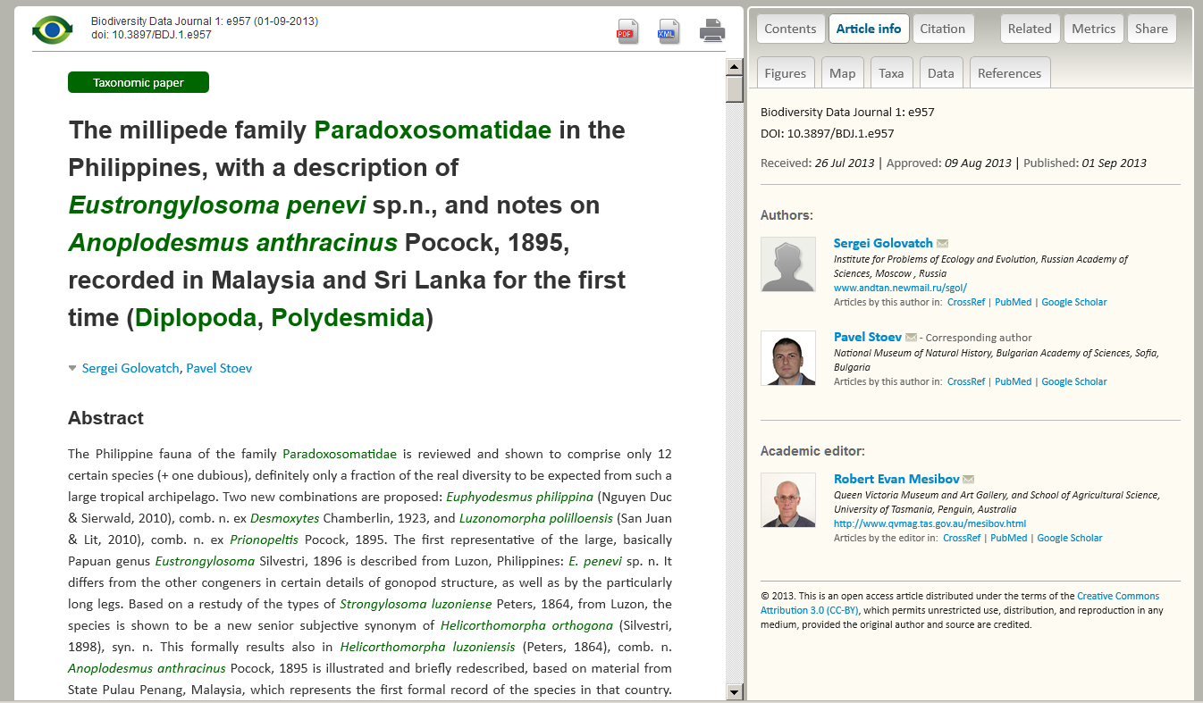
Article metadata

Slide 48
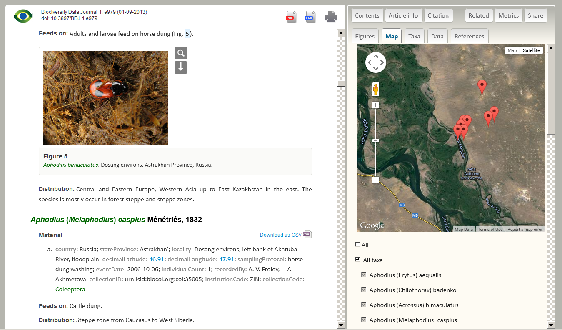
Map localities

Slide 49
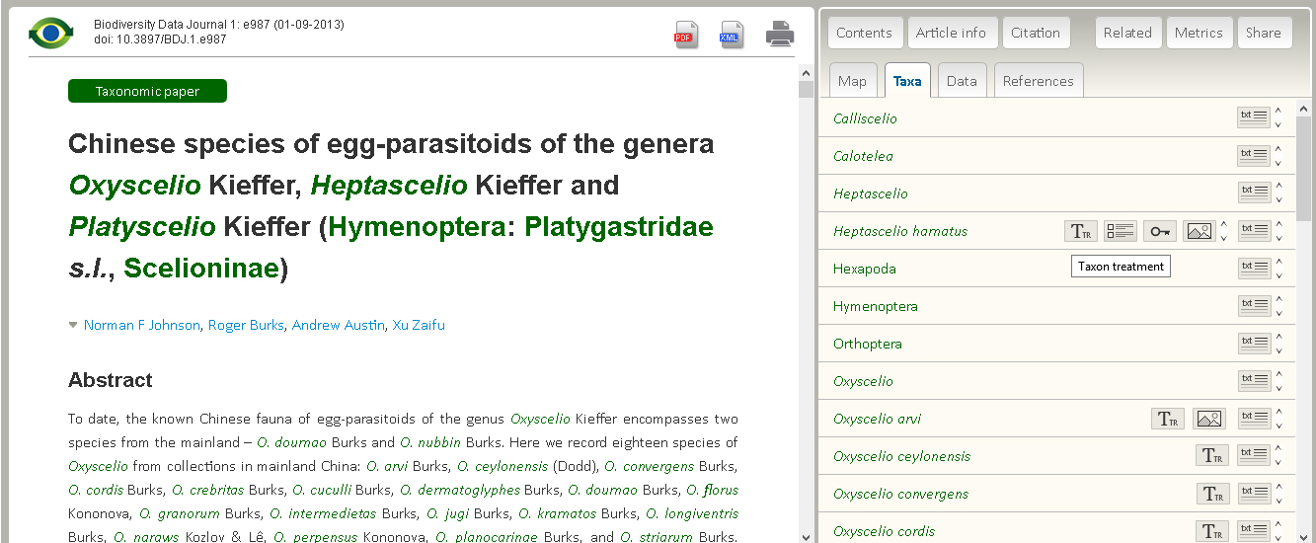
Taxa and their usages

Slide 50
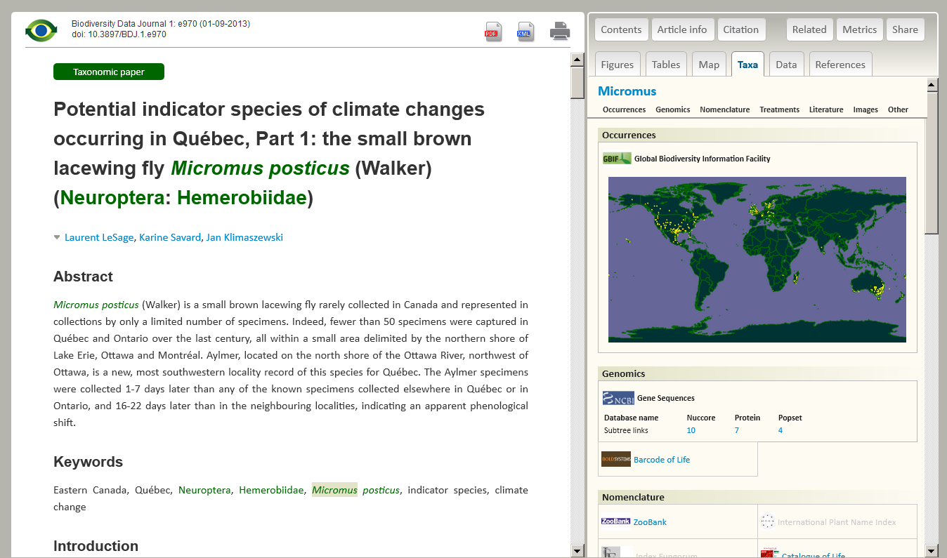
Taxon profile

Slide 51
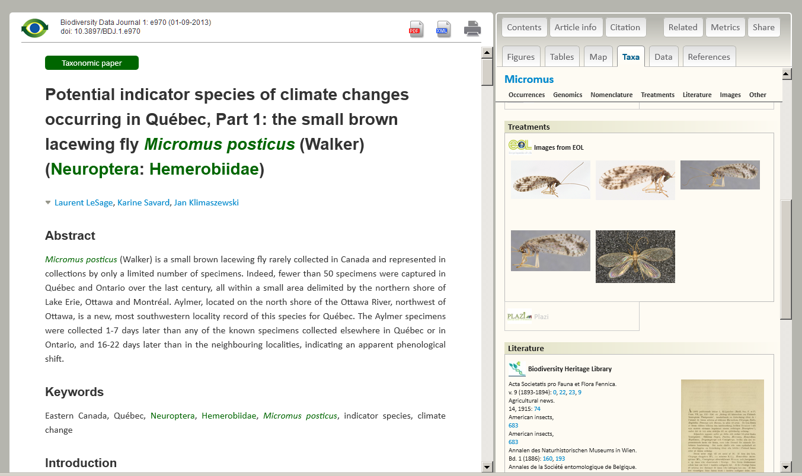
Taxon profile

Slide 52
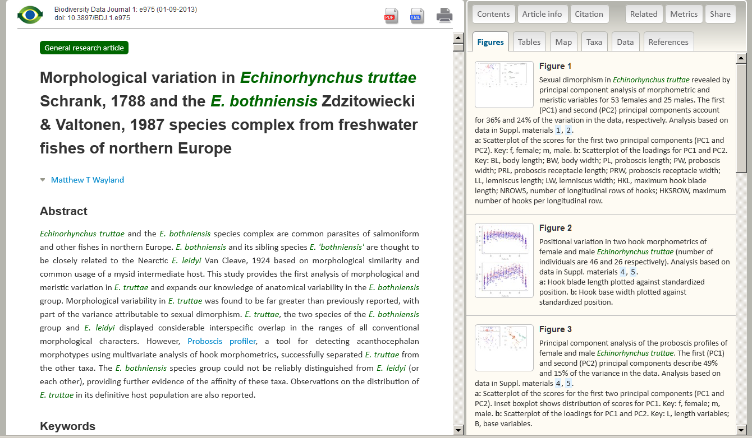
Tables and Figures

Slide 53
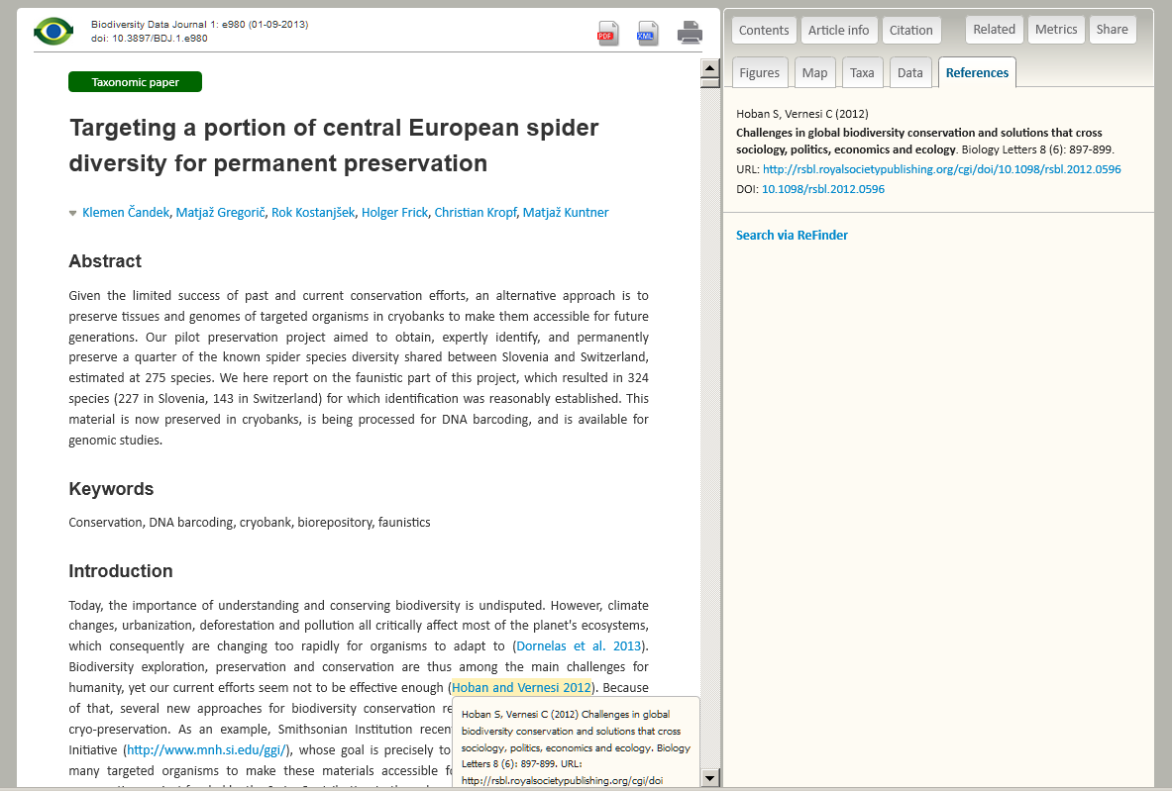
References

Slide 54


Slide 55
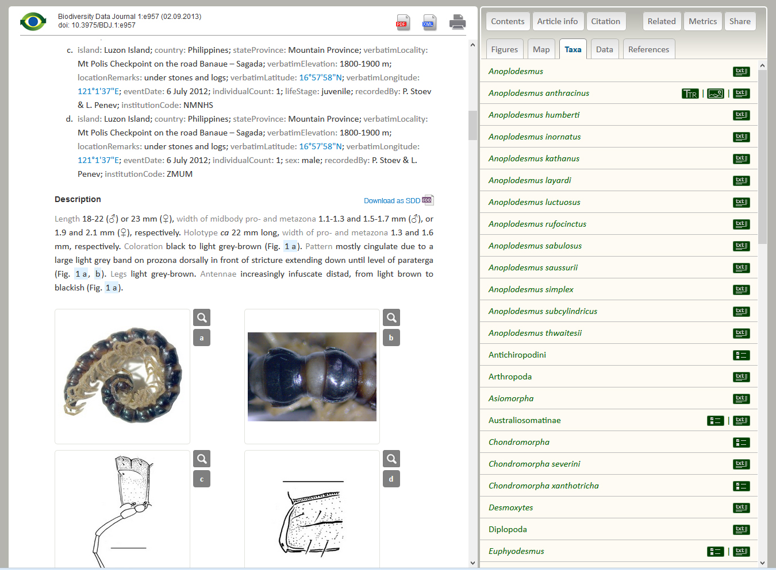

Slide 56
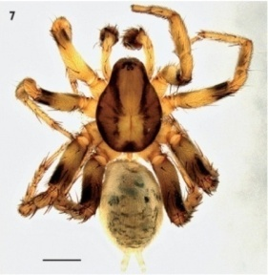
Possible solution for “dark” taxa
Pwt – collaborative
article authoring tool
Dark taxon sequenced
manuscript finalization
& SUBMISSION
Automated submission to Pensoft Writing Tool
Bdj – peer-review
BOLD Metadata:
voucher specimen,
images, locality, etc.
MANUSCRIPT
PUBLISHED
Automated update of bibliographic metadata, taxon names, Zoobank records, etc.

Slide 57
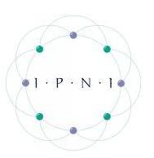

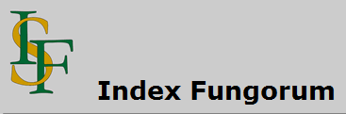
Automated pre-publication registration of new taxon names
Manuscript
SUBMISSION
Peer review
XML Query
MANUSCRIPT
ACCEPTED
XML Response
XML article metadata
ARTICLE
PUBLISHED
Taxon name available/valid
(effectively published)

Slide 58
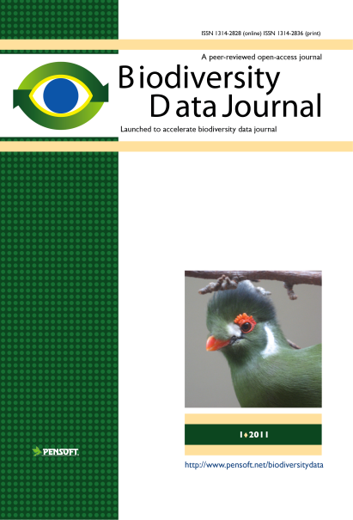
What will BDJ publish?
Single taxon treatments and acts
Local/regional and habitat checklists, sampling reports, N2K inventories
Ecological and biological observations on species and communities
Identification keys
Data papers describing data
Descriptions of software tools and work flows
Recruiting editors!
Editor Application Form http://pensoft.net/journals/bdj/editor_form.html
Notes:
58
Slide 12: Next generation article publishing
Arguably our most ambitious developments in the context of scholarly communication concern the semi-automated construction of scholarly papers from databases. In many cases Scratchpads contain extensive data relating to the biology and description of particular species. These are highly suited to formal specialist publications, but doing so require the laborious assembly of these data into a manuscript. As part of the ViBRANT collaboration with Pensoft, and in particular their two journals specialising in the formal taxonomic descriptions of plants and animals, we have developed a 5-step workflow for users to selecting appropriate data from their Scratchpad, adding additional metadata describing this information so that it conforms with the norms of descriptive taxonomic publications, and then finally preview and submit this manuscript to the publisher. From here is goes through a standard peer review process. Review recommendations are then incorporated in to a revised version of the manuscript, which is then sent back to the publisher and simultaneously published on both the Scratchpad and in the publisher’s journal.
In addition to dramatically speeding up the construction of scientific papers, the user has the advantage that firstly the manuscript can be revised and updated and new information comes to light on the Scratchpad, while preserving the original version of the manuscript as part of the scholarly record. In addition the publish extracts relevant information from the submitted database which is them automatically submitted to the specialist data repositories.
So in sum then, these are the four ways in which ViBRANT is facilitation scholarly communication of biodiversity information. 1) Through low cost journal infrastructure; 2) by community web publishing; 3) by biodiversity observation data publishing; and 4) by next generation publishing services producing scholarly articles from databases.

Slide 59
Why publish in BDJ?
Not just a journal
Even not just a data journal!
A work flow and infrastructure to mobilize, review, publish, store, disseminate, make interoperable, collate and re-use data
through the act of scholarly publishing!
Notes:
59
Slide 12: Next generation article publishing
Arguably our most ambitious developments in the context of scholarly communication concern the semi-automated construction of scholarly papers from databases. In many cases Scratchpads contain extensive data relating to the biology and description of particular species. These are highly suited to formal specialist publications, but doing so require the laborious assembly of these data into a manuscript. As part of the ViBRANT collaboration with Pensoft, and in particular their two journals specialising in the formal taxonomic descriptions of plants and animals, we have developed a 5-step workflow for users to selecting appropriate data from their Scratchpad, adding additional metadata describing this information so that it conforms with the norms of descriptive taxonomic publications, and then finally preview and submit this manuscript to the publisher. From here is goes through a standard peer review process. Review recommendations are then incorporated in to a revised version of the manuscript, which is then sent back to the publisher and simultaneously published on both the Scratchpad and in the publisher’s journal.
In addition to dramatically speeding up the construction of scientific papers, the user has the advantage that firstly the manuscript can be revised and updated and new information comes to light on the Scratchpad, while preserving the original version of the manuscript as part of the scholarly record. In addition the publish extracts relevant information from the submitted database which is them automatically submitted to the specialist data repositories.
So in sum then, these are the four ways in which ViBRANT is facilitation scholarly communication of biodiversity information. 1) Through low cost journal infrastructure; 2) by community web publishing; 3) by biodiversity observation data publishing; and 4) by next generation publishing services producing scholarly articles from databases.

Slide 60

I Open Access!
and….
ViBRANT
PLAZI

Slide 61
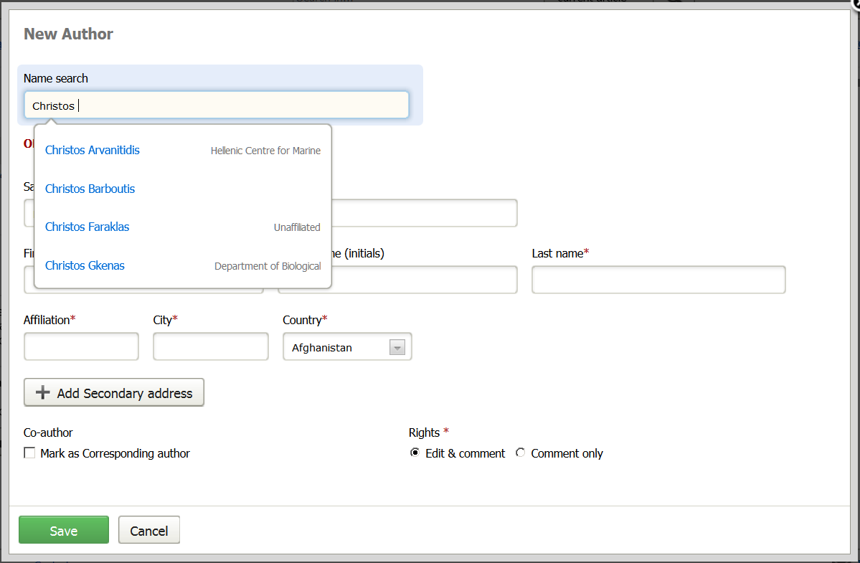
Import co-author’s profile

